Slide 1
Customer retention case study
Study of online retailers

Slide 2
Problem statement
We have many online retailors, the most important aspect for the retailors is to retain the customers.
As it is more expensive to gain new customers than it is retain the current ones, retailors spend a lot of money to keep their customer loyal to their own platform
This survey will help us dive deeper into what causes people to recommend a website/ use it again and again.

Slide 3
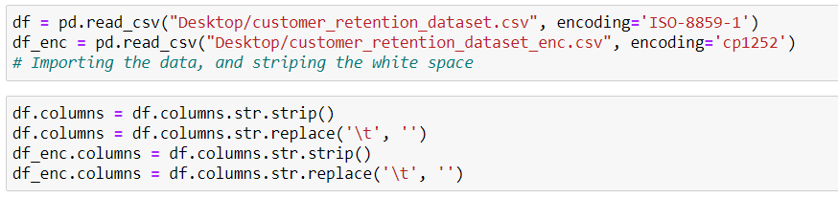
Data cleaning
Here I’ve imported the encoded as well as the non encoded data, and cleaned the data of any
White spaces as well as striping the column names of ‘\t’

Slide 4

Dividing the data into two parts
df_single contains the questions which have a single answer
df_multi contains the questions where multiple answers are allowed.

Slide 5

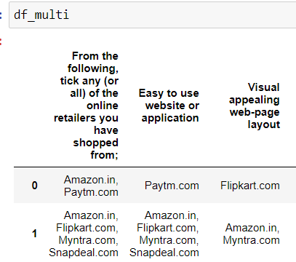
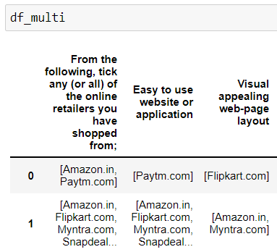
Converting df_multi responses into a list
Now we must convert the df_multi responses into a list format before we can perform any analysis on it.
Before After

Slide 6
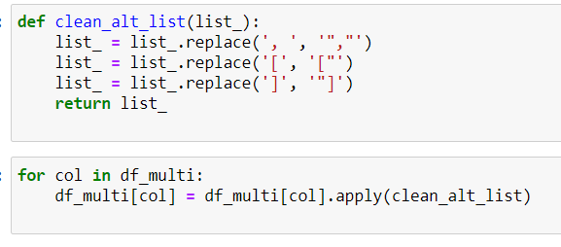
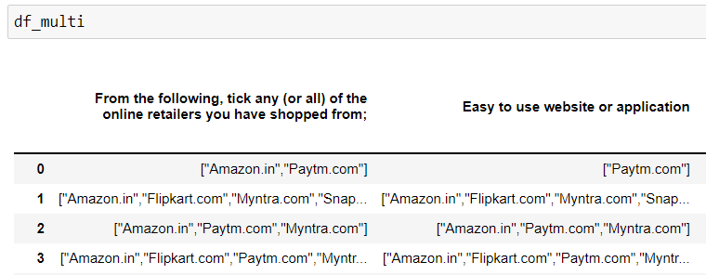
Running a script through all the coulmns
Script
Final result (list)

Slide 7
Assumptions:
Before proceeding with EDA, we have to make some assumptions
As the dataset available to us is only a fraction of the customers shopping online:
We have to assume that this data set is not biased towards any field
That is, we have to assume that the ratios of say the gender are similar between our data and the actual data.
We might have, outliers, overfitting and most important of all smapling bias; which we will ignore for this study

Slide 8
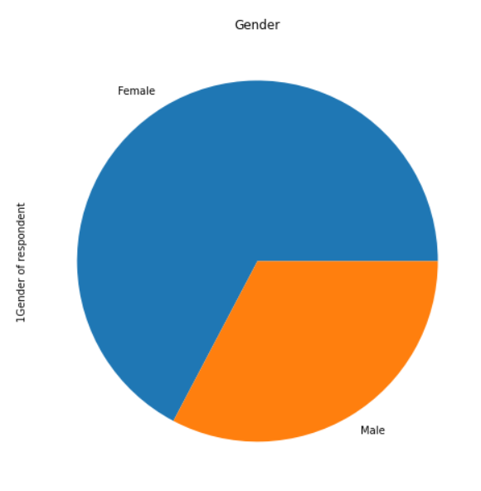
Gender
We can see that,
the majority of online shoppers
are women

Slide 9
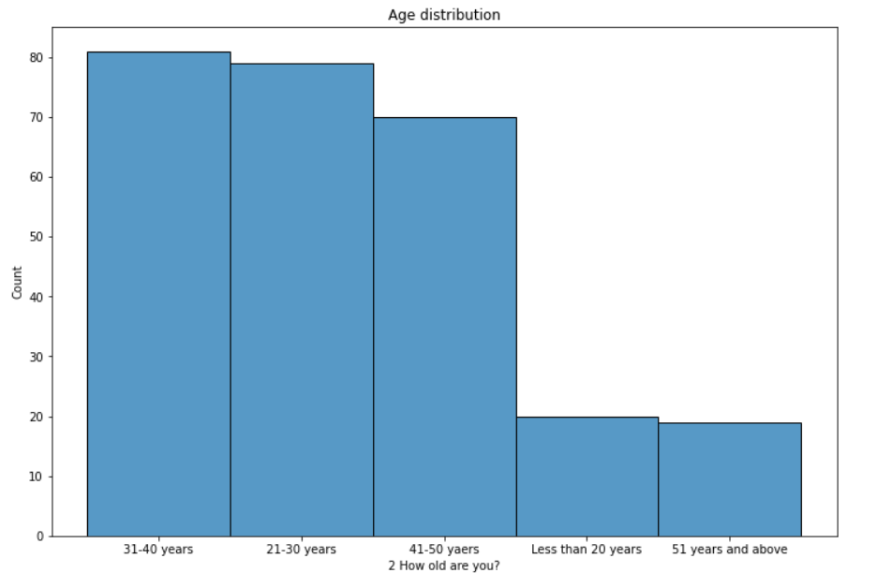
Age distribution
We can see that that majority of respondents are between 21 and 50 years old

Slide 10
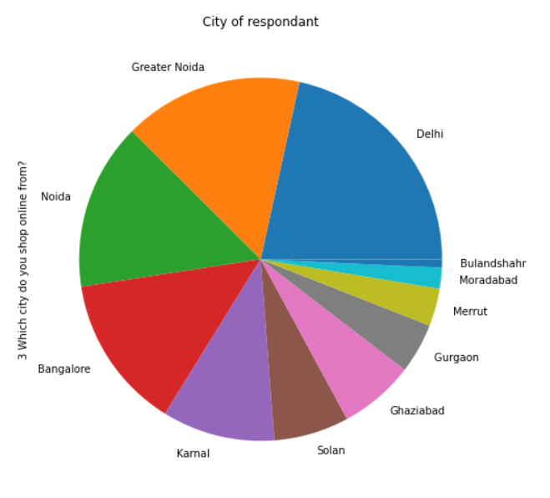
City of respondants
Here we can see where the people are located

Slide 11
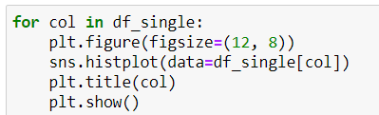
Similarly, using a script each and every column was converted into a histogram
All the plots are available in the jupyter notebook.
Script used to generate the plots:
This script iterates through all the columns and generates an individual plot for all of them.

Slide 12
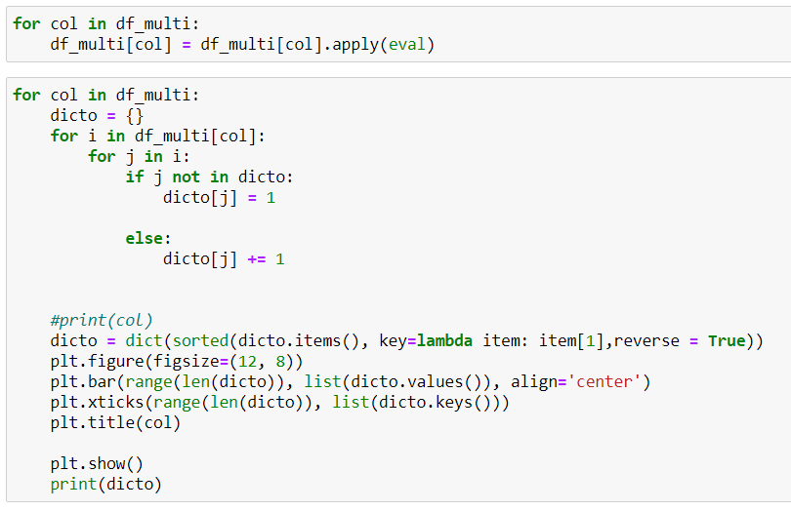
Another script for multiple answer questions
This script plots the values of each website in every question, along with a dictionary printed below each graph of the results.

Slide 13
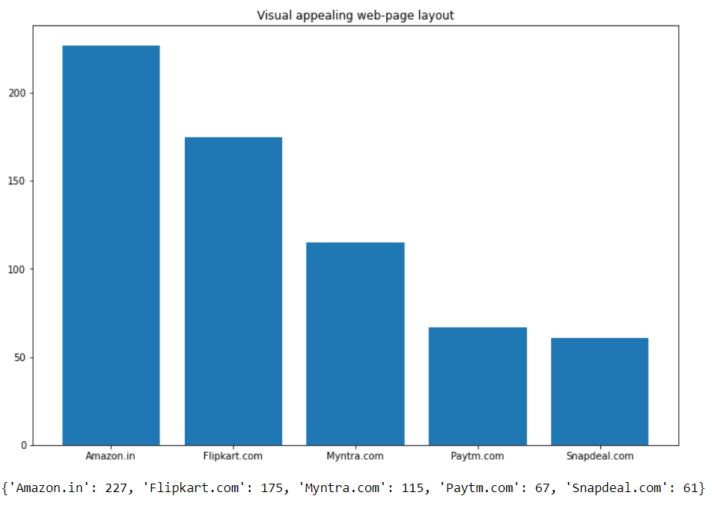
One of the responses of the above script
A similar graph is plotted for each and every column

Slide 14
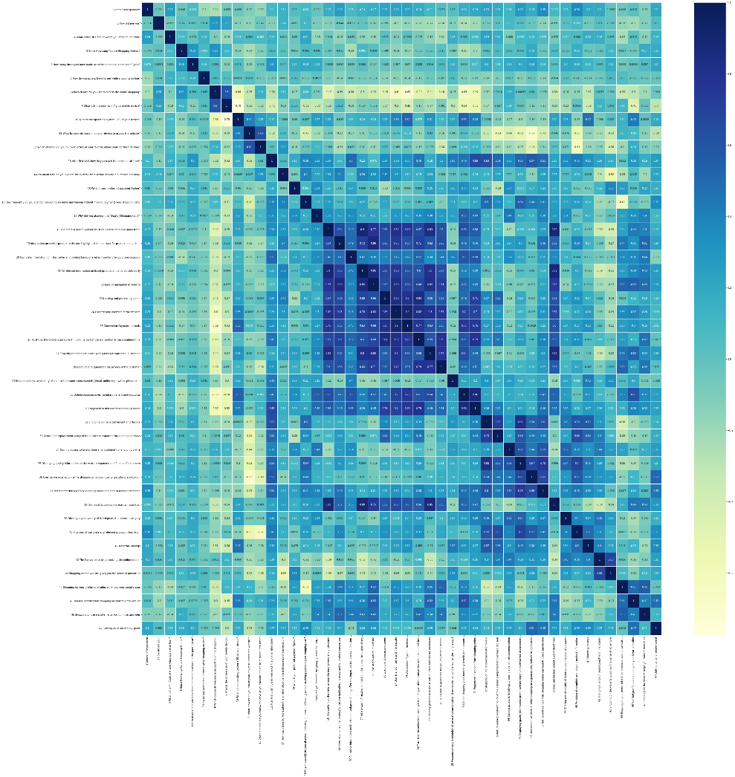
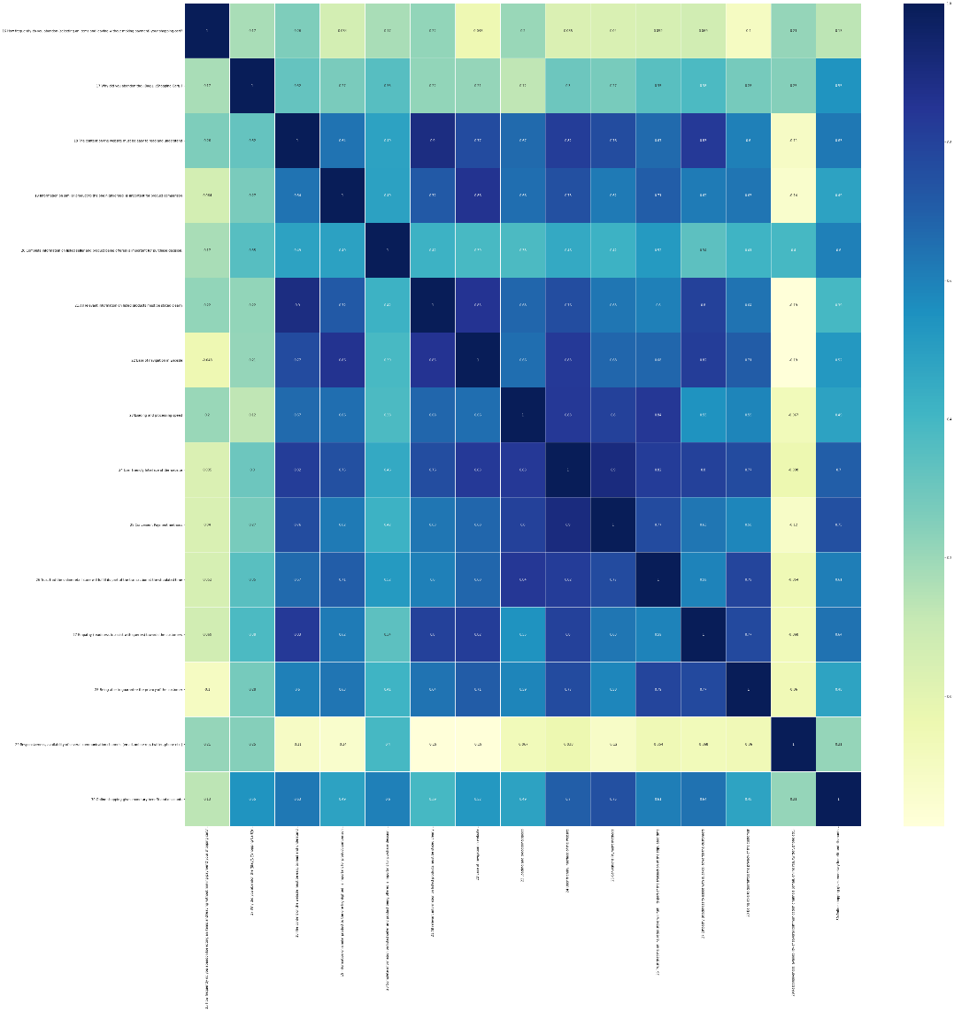
Co-relation matrix (from df_enc)

Slide 15
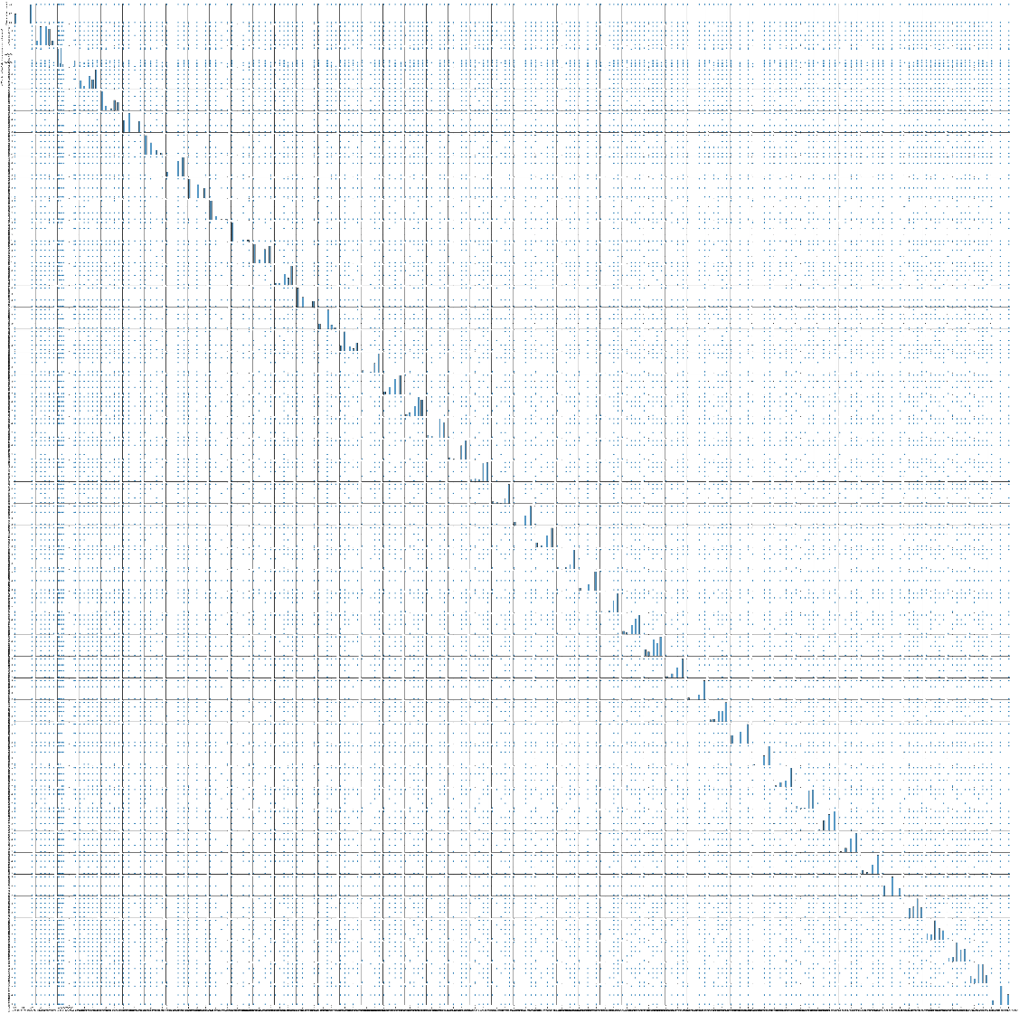
Pairplot of the columns

Slide 16
Conclusion
Online retailors should value the values of it's customers, the best way to do that is providing a fast website which does not track users; providing:
high service quality (good customer support)
high system quality (fast website which loads quickly),
a good information quality (by having the best product deals, alternative choices as recommended products)
trust and net benefit (fast deliveries, best offers)

